Slide 1
Web Design with HTML and CSS
Day 7

Slide 2
Using Multimedia
Multimedia – It is the fusion of text, images, sound, and video to exhibit an idea or convey a message
Many websites use videos to publicize products, to please visitors, or to provide instruction
Podcasts – They are a series of audio or video clips released in a sequence and are popular in home, academic, and corporate settings

Slide 3
Creating Multimedia Files
One can obtain multimedia files by creating them or finding files that are already available
Audio files can be created using:
a microphone
a software designed to edit digital files, such as Audacity
a free, open-source audio editor
Adobe Audition, which can be purchased as part of the Adobe Creative Cloud

Slide 4
Creating Multimedia Files
In order to use any portion of files that have been professionally developed, the copyright and licensing requirements must be understood and followed
Video files can be created using a digital camcorder, a digital camera, or even a smartphone to create clips that can be included on a webpage
To find multimedia resources on the web that are available free of copyright restrictions, search for “public domain audio or video”

Slide 5
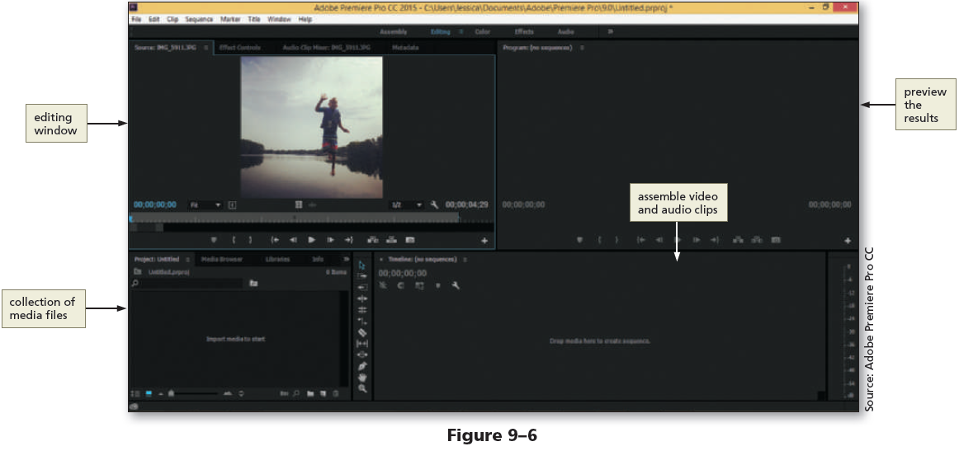
Creating Multimedia Files

Slide 6
Embedded vs. External Multimedia
Embedded Multimedia
The embedded media files appear within the webpage along with the audio or video player controls
Visitors use the controls to play or stop the media
External Multimedia
The external media is displayed out of context with the webpage that contains the link
Website visitors click a link to access external media files

Slide 7
Embedded vs. External Multimedia
Embedding media is similar to inserting inline images
Prior to HTML5, the object element was used to insert embedded content, including multimedia
Two new elements introduced by HTML5, audio and video, can be used as an alternative to the object element

Slide 8
Embedded vs. External Multimedia
Using external links is a common web development practice
For example, sites that provide video resources, such as YouTube, use external media files and the embed element, which defines a container for an external application or interactive content (also called a plug-in)

Slide 9
Media Players and Plug-Ins
Media player – A computer software that is used to play multimedia files
Plug-in – An extra software added to browsers (or other programs) to provide a capability that is not inherent to the browser
Plug-in is also called an add-in or add-on
For embedded media files to work in a browser, website visitors need to have the correct plug-in

Slide 10
HTML5 and Multimedia
Built-in media support is introduced in HTML5 through the audio and video elements
Web developers can easily embed media into HTML documents using the audio and video elements

Slide 11
Flash
Flash, or Adobe Flash, has been used within websites for approximately 20 years
It can be used to create animations or movie files
Flash files require the browsers to have a Flash plug-in and end with the .swf file extension
Since the iOS operating system does not support flash, web developers have embraced JavaScript to incorporate additional interactivity within their websites

Slide 12
Java Applets
Java applet – A small program created with Java, a programming language
If browsers have installed and enabled Java, Java applets can be embedded within a webpage
The use of Java applet in today’s modern websites is deteriorating

Slide 13
Object Element
The HTML object element is used to embed multimedia objects such as Flash files, Java applets, PDF files, and ActiveX controls
The param element is used to define parameters for plug-ins embedded with an object element

Slide 14
Object Element
The following is an example of the object element
<object data="audio.wav">
<param name="autoplay" value="true">
</object>
In this example, an audio file named audio.wav is embedded on the webpage
The autoplay parameter is set to true, meaning the audio starts playing when the webpage opens

Slide 15
Integrating Audio
Audio blended within a webpage should have a definite purpose and should provide added value or instruction
The time taken for a browser to load the audio file should also be considered
One favored way that websites use audio is to provide links to music files that visitors can play or download

Slide 16
Audio File Formats
The three audio file formats supported by the HTML5 audio element are .mp3, .ogg, and .wav
Audio converter software can be used to convert files from one audio format to a supported format
File compression techniques are used to reduce the size of the audio files for the web, though they can also diminish the sound quality

Slide 17
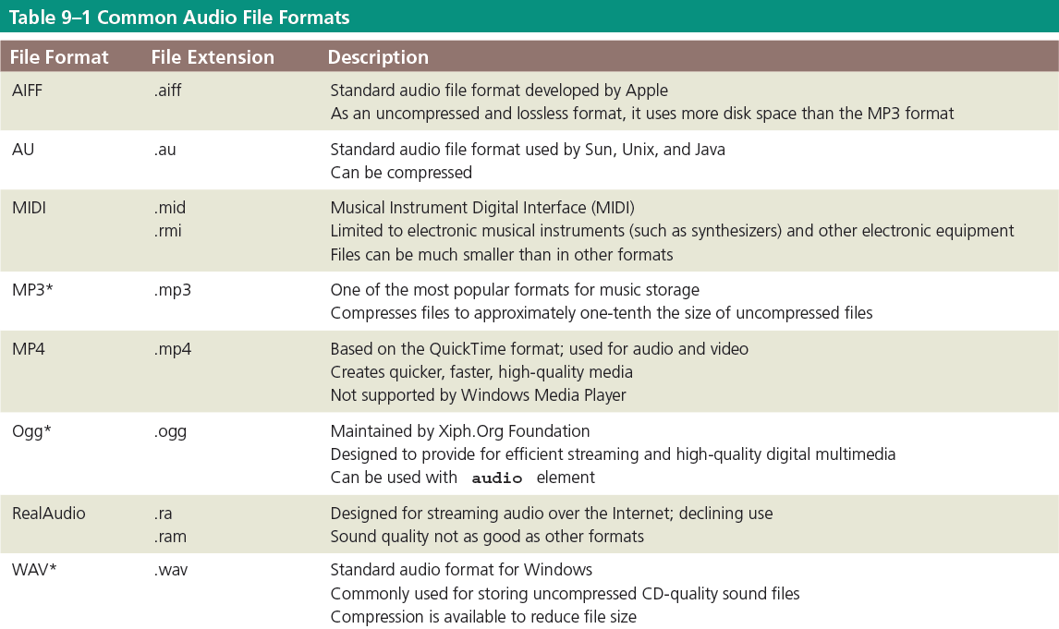
Audio File Formats

Slide 18
File Compression and Codecs
Codec – A compression technology used to compress images, audio, and video files
The word codec is short for code/decode because it consists of an encoder, which compresses the file, and a decoder, which decompresses the file
Although the page load time is improved using codecs, compressing a media file too much leads to loss of sound quality

Slide 19
HMTL5 audio Element
The audio element is used to define sound, such as music or other audio streams
Text content should be inserted between the <audio> and </audio> tags because browsers that do not support the audio element ignore the <audio> tag to alert users

Slide 20
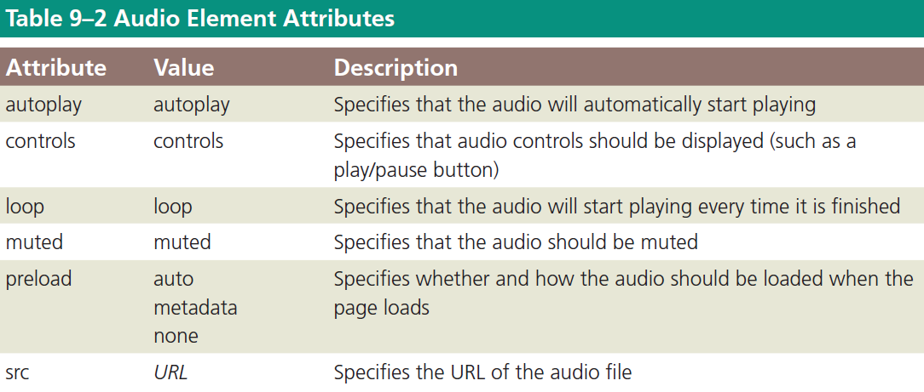
HMTL5 audio Element

Slide 21
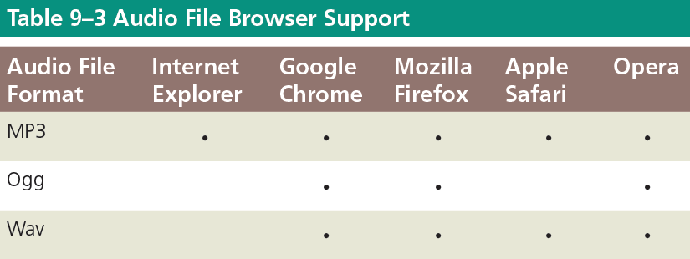
HMTL5 audio Element

Slide 22
Add Audio to the Home Page
Go into the “WA110 Data Files” folder, click on the “CH9 Part1 Data” folder. Then open “fitness” and then the “media” subfolder. COPY the files contained within.
Navigate to your “fitness” project folder, then open the “media” subfolder. PASTE the contents in this folder. (Should be SIX files in all).

Slide 23
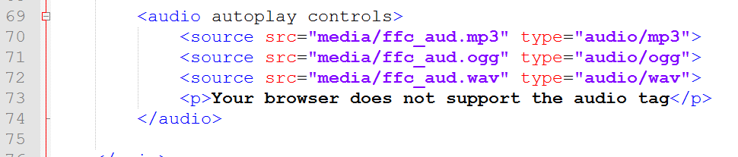
Add Audio to the Home Page
Open “index.html” in Notepad ++
Click at the end of Line 67 and press ENTER twice to insert new Lines 68 & 69.
Add the code shown which include audio controls as well as file sources to accommodate different browsers.

Slide 24
Add Audio to the Home Page
As additional options:
The “loop” attribute can be added to the audio tag. This will automatically replay the audio file once it has finished.
Removing the “controls” attribute will effectively hide the audio player controls from the web page itself.
*Keep in mind: The audio can be distracting and annoying if looped continuously. Sometimes playing it once is enough to get the effect. Also, not allowing the user the option to pause or lower the volume could also lead to a negative user experience.

Slide 25
Video File Formats
The three video file formats supported by the HTML5 video element are .mp4, .ogg, and .webm
Video converter software can be used to convert an unsupported video file format to a supported format

Slide 26
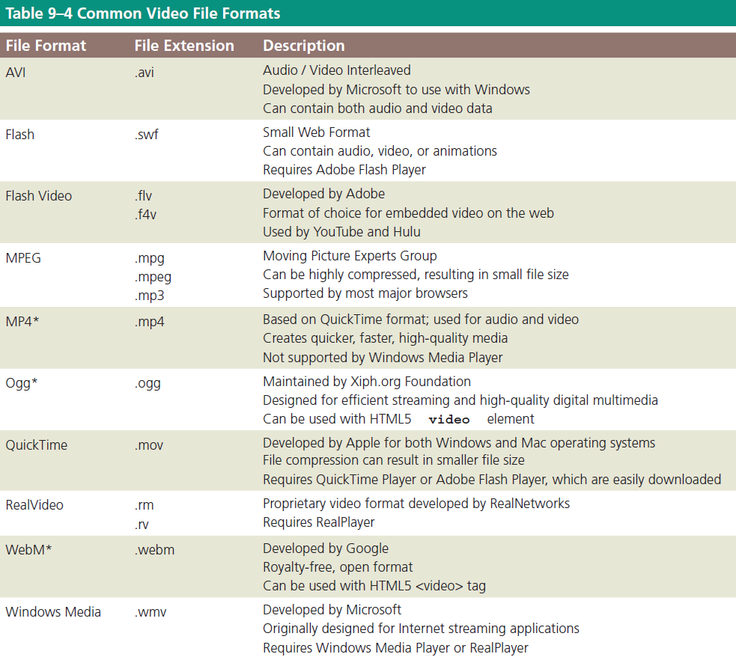
Video File Formats

Slide 27
HTML5 video Element
Three HTML elements can be used to incorporate videos in a webpage: embed, object, and video
The embed element is used to embed multimedia elements in HTML pages
If Flash is not supported by browsers, the video specified in the embed element will not play

Slide 28
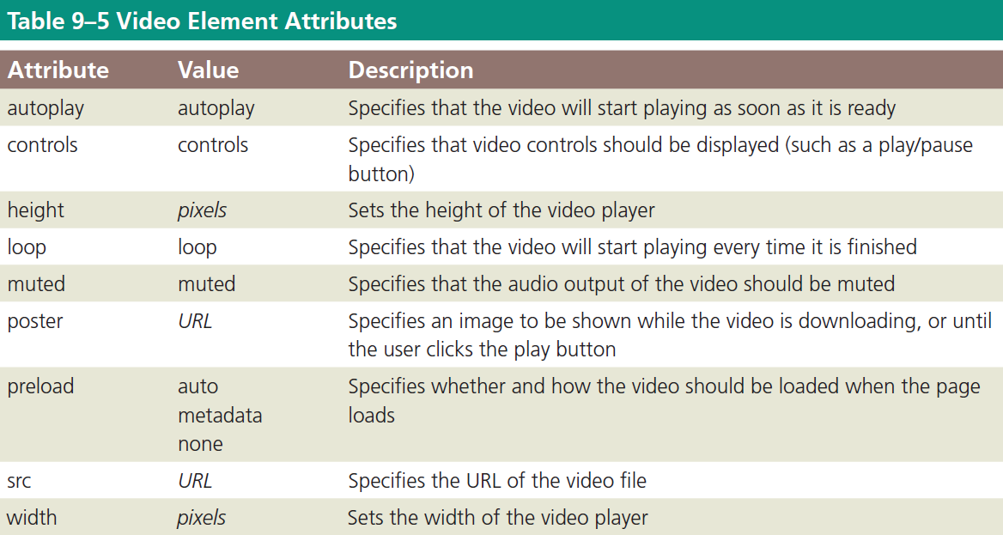
Using the video Element

Slide 29
Using the video Element
Text content should be inserted between the <video> and </video> tags because browsers that do not support the video element ignore the <video> tag to alert users
The following sample code shows how to use the video element to insert a video file named advertisement.mp4 in a webpage
<video width="320" height="240" controls="controls">
<source src="advertisement.mp4" type="video/mp4">
<p>Your browser does not support the HTML5 video element.</p>
</video>
In the above example, the code sets the dimensions of the video (320 pixels by 240 pixels) and displays the playback controls

Slide 30
Using the video Element
If the browser does not support the video element, the user is alerted
The controls attribute adds video controls including play, pause, and volume
The video element allows multiple source elements, which can link to different video files

Slide 31
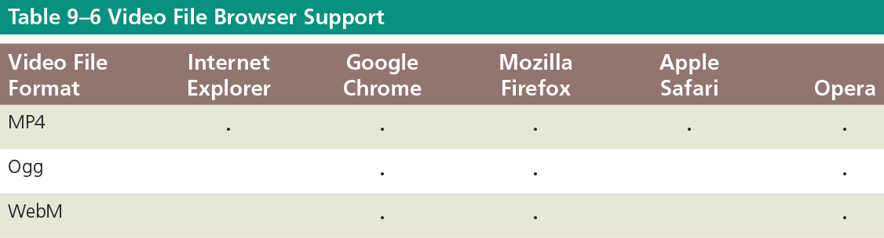
Using the video Element

Slide 32
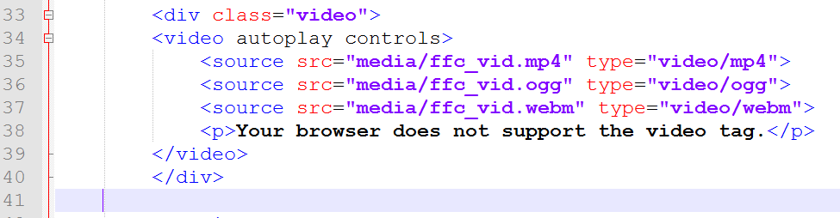
Add Video to the About Us Page
Open “about.html” in Notepad++
Click at the end of Line 31 and press ENTER twice to insert new Lines 32 & 33.
On Line 33, increase the indent, then add the code to first create a <div> and then the video element with source file info.

Slide 33
Chapter 10
Creating Interactivity With Social Media

Slide 34
Using Social Media
Social Network
It is an online community where members post and exchange social media content
It allows members to share information and ideas with fellow online community members
It allows businesses to immediately connect with their customers and potential customers and instantly engage them with new product information

Slide 35
Using Social Media
Facebook
It is a social networking site with more than one billion users
Users include individuals and businesses
A business can create a Facebook page and use it to advertise its products and services
Individuals can “like” a business by clicking a button to indicate that they use or approve of a produce
Obtaining “likes” is a goal for most businesses, as this increases its presence and positive perception

Slide 36
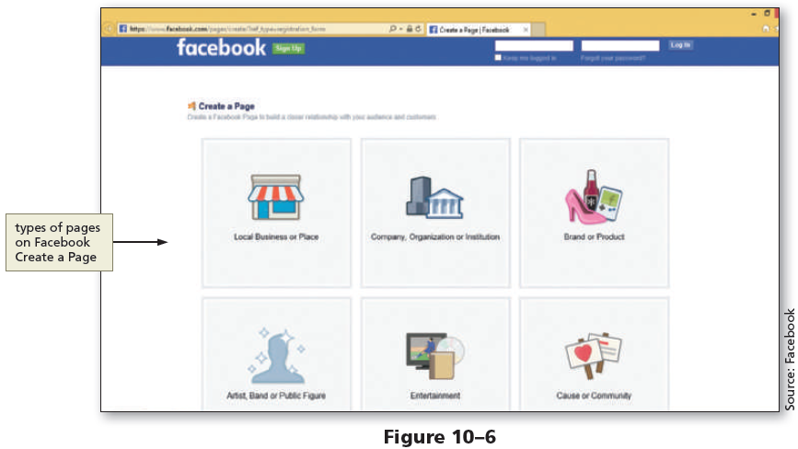
Using Social Media

Slide 37
Using Social Media
Twitter
It is a social networking site used to post short comments or updates
Each post, known as a tweet, is limited to 140 characters
Customers have the option to follow a business on Twitter
It provides marketing opportunities for business to help with a content strategy, to engage and obtain more customers, and to measure marketing results in real time

Slide 38
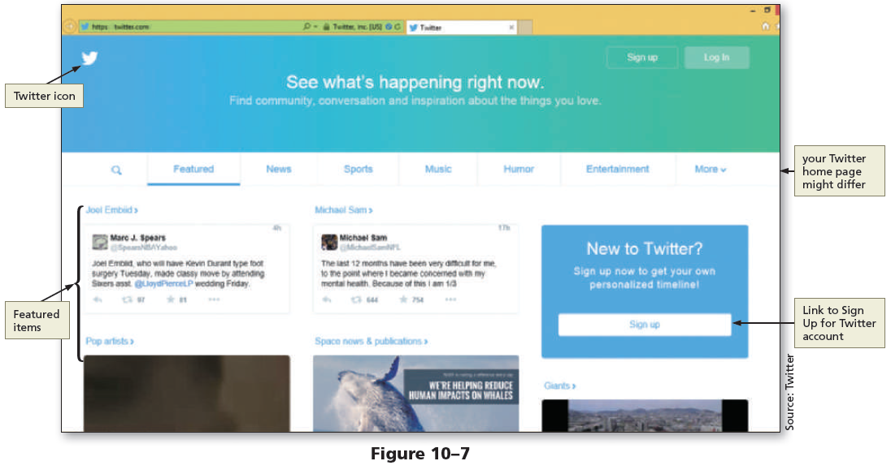
Using Social Media

Slide 39
Using Social Media
Google+
A Google account is required to use it which can be created for free at plus.google.com
Once an account is established, people are added to circles
Circles are groups or categories, such as friends, family, and acquaintances

Slide 40
Using Social Media
Google+
Businesses use Google+ to post special offers and pictures of new products to share with their customers
Businesses have an added benefit because Google+ works with Google’s search engine, increasing the probability of a potential customer finding the business through Google’s search engine

Slide 41
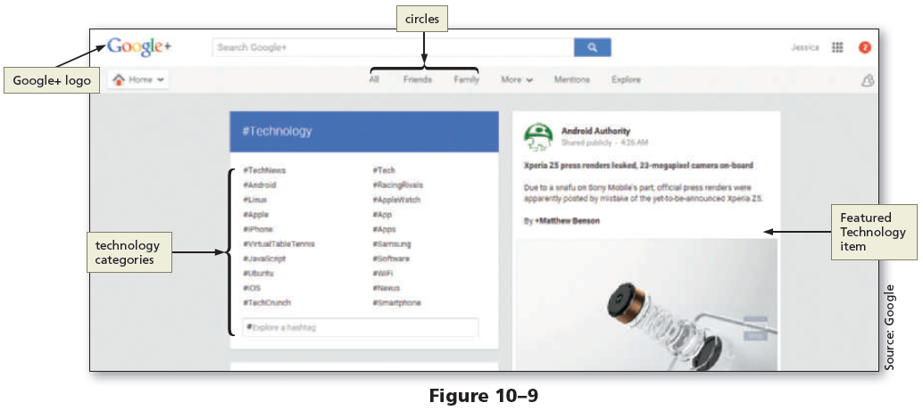
Using Social Media

Slide 42
Using Social Media
YouTube
It is a social media website where members can upload and share original videos and subscribe to a channel
Businesses purchase ad space on YouTube to attract its target audience or create their own channel and upload videos
Business ads can be a banner image that is displayed on the lower part of a video or a full-length commercial that plays before the selected video

Slide 43
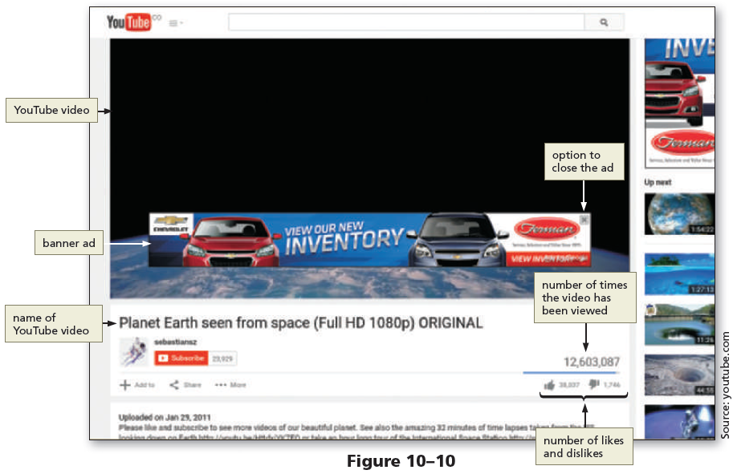
Using Social Media

Slide 44
Using Social Media
Instagram
It is a social networking site where members can upload and share photographs, images, and video
It allows users to connect and express ideas with captivating visual photography
The free app allows users to apply various filters to enhance photographs, images, and video
Businesses use it to promote brand awareness

Slide 45
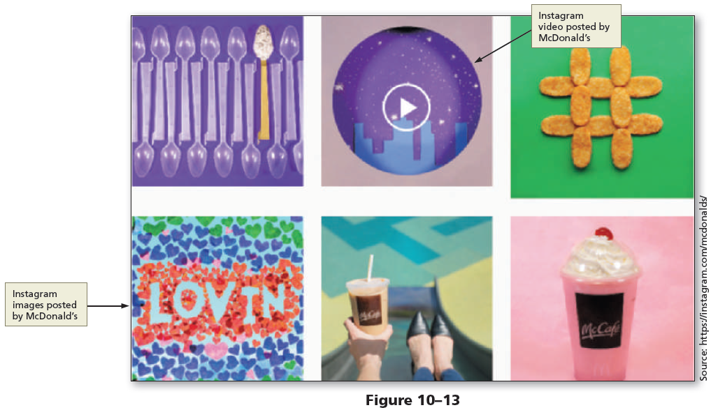
Using Social Media

Slide 46
Using Social Media
Pinterest
It allows members to browse and “pin” ideas found on the web
Users search for ideas for just about anything, including recipes, crafts, photography, and do-it-yourself (DIY) projects
They can follow boards that interest them most and “pin” photos, links, and comments to their own board for future use

Slide 47
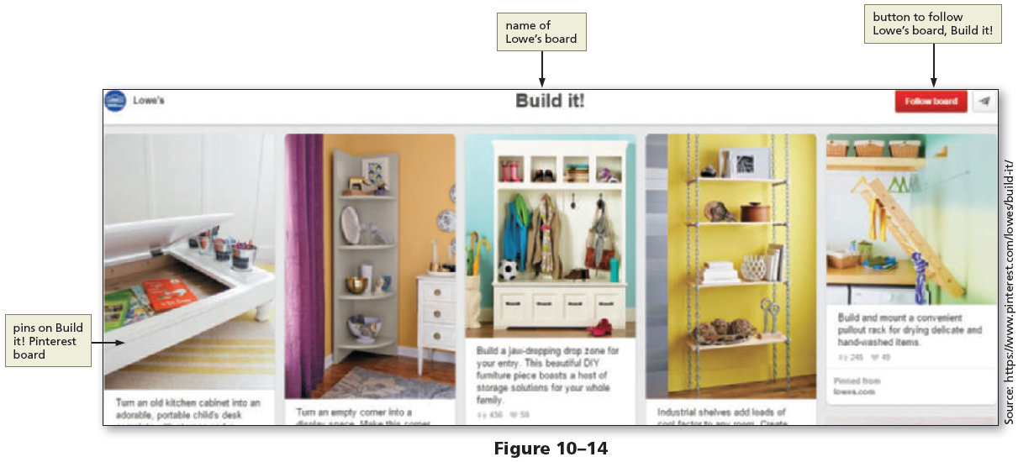
Using Social Media

Slide 48
Using Social Media
Other Social Media Options
Other social media options for a business to explore include LinkedIn, Quora, Tumblr, StumbleUpon, Flickr, Delicious, Digg, Vine, Foursquare, and many more
The key is to determine which social media outlets are best for a business in attracting new customers
A business owner must also consider the time involved with keeping the social media current and relevant

Slide 49
Using Social Media
Blogs
Are online journals, maintained by individuals, groups, or businesses
“Blog” is short for a combination of the words web and log
Businesses use them to share new information and to keep their customers engaged
Business owners who maintain blogs should respond to customer comments on time and keep their blog content fresh

Slide 50
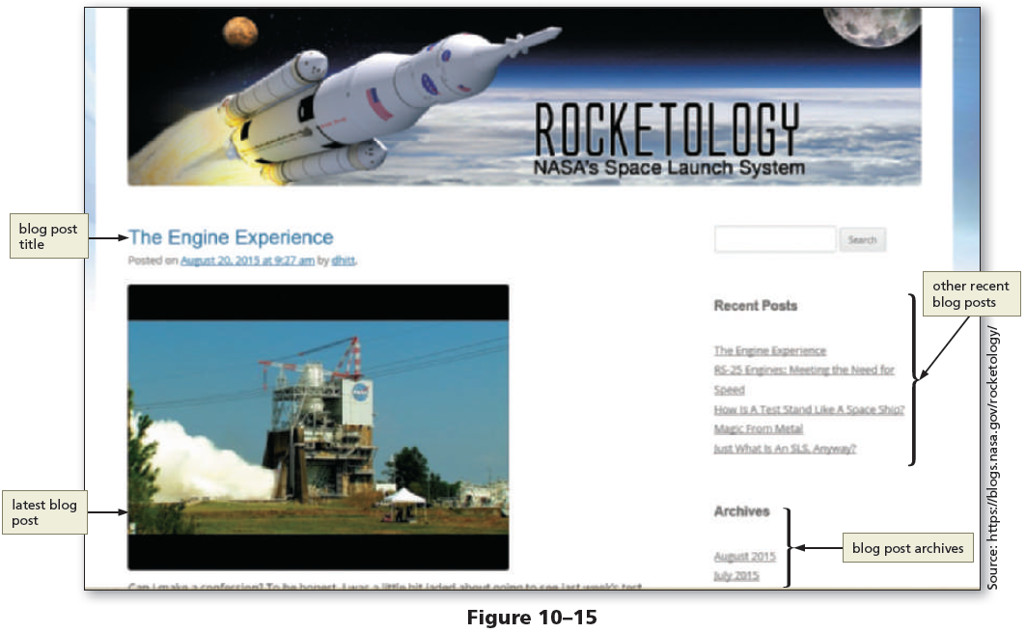
Using Social Media

Slide 51
Using Social Media
Adding Facebook and Twitter Links to a Website
Businesses that use social media display social media icons and links on their website, which lets their customers know how to connect with the business on social media
When users click a social media icon, they are redirected to the social media page for the business
Social media links are typically included near the top or bottom of a webpage

